Slide 1
PERSONAL ASSISTANCE AND HEALTH CARE
SURREY COMMUNITY COLLEGE
EA PROGRAM
2014

Slide 2
OVERALL PROGRAM OBJECTIVE:
To ensure that students are transferred and repositioned in a manner that is appropriate for their care AND safe for both the client and the caregiver.

Slide 3
PROGRAM CONTENT INCLUDE:
Review of Musculoskeletal Injuries (MSI)
Understand Importance of Body Mechanics
Review of Safe Material Handling
Review of Mobility and Mobility Aids
Review of Immobility
Knowledge of a Mobility Assessment
Review and demonstrate Safe Client Handling Techniques

Slide 4
HEALTH AND SAFETY COMPONENTS
Review of Policy,
Procedure and
Process – Best Practice
Knowledge of Equipment
Understand Importance of Client Assessment for Method of Transfer
Education & Training
i.e. MSI, Body Mechanics

Slide 5
MUSCULOSKELETAL INJURIES (MSI)
WHAT IS A MSI?
  Musculoskeletal Injury (MSI) is defined as an injury or disorder of the muscles, tendons, ligaments, joints, nerves, blood vessels or related soft tissue (WorkSafe BC Occupational Health and Safety Regulation, 1999).
  Examples of MSIs include: strains and sprains, tendonitis, bursitis.
  In healthcare, the back, neck and shoulder are affected.

Slide 6
MUSCULOSKELETAL INJURIES (MSI)
RISK FACTORS:
FORCE
  i.e. lifting or lowering a heavy object/box, pushing or pulling a cart
AWKWARD POSTURES
  i.e. Reaching, twisting
STATIC POSTURES
  i.e.. Carrying a heavy object for a long distance, starting and IV, performing a dressing change

Slide 7
MUSCULOSKELETAL INJURIES (MSI)
RISK FACTORS:
REPETITION
  i.e. assembly line workers (performing the same task over and over)
CONTACT STRESS
  i.e. resting forearm on edge of desk while typing
*With more than one risk factor present in a task, the level of risk increases *

Slide 8
MUSCULOSKELETAL INJURIES (MSI)
SIGNS & SYMPTOMS OF A MSI:
Redness
Swelling
Difficulty moving a particular body part
Numbness
Tingling
Pain
S&S can appear suddenly or gradually
  It is important to recognize S&S of MSI’s so that treatment can be started ASAP.

Slide 9
MUSCULOSKELETAL INJURIES (MSI)
WHAT TO DO IF YOU NOTICE A STRAIN OR SPRAIN AT WORK:
  Report injury immediately to supervisor/instructor
  Seek medical attention

Slide 10
MUSCULOSKELETAL INJURIES (MSI)
REDUCING THE RISK:
Stretch: before work and throughout your shift
Follow good body mechanics
Improve your posture
Reduce force
Reduce frequency
Review activities
Awareness of Refusal Of Unsafe Work Policy (WorkSafe B.C.)
Follow Safe Client Handling Policy or other facility policy
Notes:
Stretch : Refer to handout
Body Mechanics: Next topic
Improve your posture: take time to adjust yourself, the patient, or the equipment to get in a better position. Change postures and activities often (e.g. stretch, adjust your chair, do another task).
Reduce force: use patient handling equipment (e.g. lift) or material handling devices, (e.g., cart), keep tools sharp, grip lightly.
Reduce frequency: intersperse a variety of tasks throughout the day, alternate hands.
Review activities: review outside work activities that may aggravate a condition such as hobbies and sports.
Safe Client Handling Policy
Refusal Of Unsafe Work Policy

Slide 11
MUSCULOSKELETAL INJURIES (MSI)
POLICIES
Please be aware of school policies related to Safe Student Handling

Slide 12
BODY MECHANICS
  Body mechanics means using the body in an efficient and careful way.
      It involves good posture, balance, and using your strongest and largest muscles for work
  Good body mechanics reduces the risk of injury
  Fatigue, muscle strain and injury can result from improper use and positioning of the body
Notes:
Refer to Handout package “MSI, Body Mechanics and Safe Material Handling” and review handouts:
Working in Neutral
STABLE
General Tips for Material Handling, Handling Carts, Handling Laundry Bags, Changing Dressings, Dispensing Medications and Crushing Pills and Bed Making

Slide 13
BODY MECHANICS
  Body alignment (posture) is the way the head, trunk, arms, and legs are aligned with one another (includes line of gravity).
  Good alignment lets the body move and function with strength and efficiency.
  Good body alignment reduces strain on the muscles and joints and prevents injury.
Notes:
Individuals with limited mobility, correcting body alignment can help prevent disabling complications such as muscle atrophy and contractures.

Slide 14
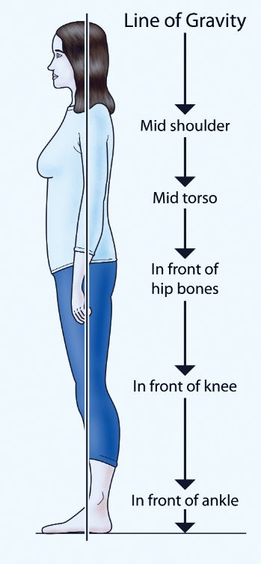
LINE OF GRAVITY

Slide 15
BODY MECHANICS
  Base of support is the area on which an object rests.
    For balance, a wide base is better then a narrow base:
      Feet are about shoulder-width apart
      Toes are pointing forward,
      Lunge (stride) stance - one foot slightly forward.
Notes:
Have students get up and practice: base of support, then return to sitting.

Slide 16
BODY MECHANICS
  General Guidelines:
  Always assess the situation first
  Face your work area
  Use your strongest and largest muscles
  Bend your knees and squat to lift a heavy object.
  Tighten stomach muscles and tuck in your pelvis
  Hold objects close to your body when lifting, moving or carrying them
  Avoid bending, reaching or twisting
  Push, slide or pull or slide heavy objects rather than lifting them.
  All activities require good body mechanics.
Notes:
Use your strongest and largest muscles. in the shoulders, upper arms, hips, and thighs to handle and move persons and heavy objects
Bend your knees and squat to lift a heavy object.
Do not bend from your waist.
Hold items close to your body and base of support.
This involves upper arm and shoulder muscles.
Instructor to demonstrate/give examples

Slide 17
PRACTICAL APPLICATION
Stand up, placing your feet approximately the width of your hips.
Sway your body gently from side to side, noticing how stable you feel.
Move your feet closer together and sway gently.
  Do you feel more or less stable than you did when your feet were further apart?
Leaving your feet hip width apart, rise up on your toes.
  How stable do you feel?
Stand on one foot.
  How stable do you feel?
Stand up with feet close together and shut your eyes.
  How stable do you feel?
Notes:
Have students stand up and practice above; discuss.

Slide 18
BENEFITS OF MOBILITY
Physical
Social
Psychological
Notes:
Ask students to brainstorm on the benefits and write on the board.

Slide 19
BENEFITS OF MOBILITY
PHYSICAL:
Improved:
  musculoskeletal strength
  circulation
  breathing
Helps to maintain:
  muscle mass
  muscle tone
  overall fitness.
Provides practice walking
  reducing the risk of falls

Slide 20
BENEFITS OF MOBILITY
SOCIAL:
Enables the person to:
  Get out
  Visit
  Interact
  Maintain social skills
  Broaden range of activities

Slide 21
BENEFITS OF MOBILITY
PHYSIOLOGICAL
Satisfaction
Control
Self-worth
Confidence
Cognition
Can reduce feelings of sadness, boredom and isolation.

Slide 22
MOBILITY
ASSISTING PEOPLE WITH MOVEMENT
Psychological Dimension
Physical Dimension
Notes:
Assisting People With Movement has 2 dimensions: Psychological Dimension and Physical Dimension

Slide 23
MOBILITY
ASSISTING PEOPLE WITH MOVEMENT
Psychological Dimension
Feelings about relying upon another person for help
Desire to move
Personal culture
  Feelings about being touched, having a caregiver physically close
Changes in thinking and understanding

Slide 24
MOBILITY
ASSISTING STUDENTS WITH MOVEMENT
Physical Dimension
Student’s functioning
  Degree of control over movement
  Strength
  Endurance
  Range of Motion
  Ability to Weight Bear
  Balance

Slide 25
IMMOBILITY
Immobility
  Inability to move about freely
Bed rest
  An intervention that restricts student for therapeutic reasons
Notes:
Review definitions and ask the students to brainstorm on the affects of immobility and the reasons why someone may be immobile.

Slide 26
IMMOBILITY
Psychosocial Effects
Emotional and behavioral responses
  Hostility, fear, anxiety
Sensory alterations
  Sleep-wake alterations
Changes in coping
  Depression, sadness, loneliness, boredom

Slide 27
IMMOBILITY
Systemic Effects of Immobility
Metabolic
Respiratory
Cardiovascular
Musculoskeletal
Urinary and bowel elimination
Integumentary

Slide 28
IMMOBILITY AND LIFE SPAN
Infants, Toddlers, Preschoolers Prolonged immobility delays gross motor skills, intellectual development or musculoskeletal development | Adolescents Delayed in gaining independence and in accomplishing skills Social isolation can occur
Adults Physiological systems are at risk Changes in family and social structures | Older Adults Decreased physical activity: functional decline Hormonal changes Bone re-absorption decreases (increases risk for fractures)
Notes:
Review the affects of immobility across the lifespan and affects on development

Slide 29
IMMOBILITY
Prevention of the Complications of Immobility
Metabolic
  Nutritional needs: protein, calories, vitamins (B and C)
Respiratory system
  Promotion of chest and lung expansion
  Removal of secretions
  Maintenance of patent airway
Notes:
Again have the students brainstorm on prevention strategies and write on the board.

Slide 30
IMMOBILITY
Prevention of the Complications of Immobility
Cardiovascular system
  Reducing orthostatic hypotension
  Reducing cardiac workload: discourage constipation
  Preventing thrombus formation: medications, exercise, fluid build-up
Musculoskeletal system
  Exercise and ROM
Notes:
Provide Handout package: “Exercise and Range of Motion Exercises”, and review as necessary, as the students may have already reviewed in another class. Can have the students practice/demonstrate, if time permits otherwise encourage students to review on their own.

Slide 31
IMMOBILITY
Prevention of the Complications of Immobility
Integumentary system
  Turning every 2-3 hours
  Hygienic care
  Protection: preventive aids
Elimination
  Hydration
  Nutritional intake: fiber

Slide 32
IMMOBILITY
Prevention of the Complications of Immobility
Positioning
  Supports: footboards, hand rolls, and splints
  Trapeze bar
  Bed positions: side-lying
Psychosocial
  Orientation
  Communication and student participation
Developmental
  Age-appropriate activities

Slide 33
POSITIONING THE STUDENT
The student must be properly positioned at all times
Regular position changes and good alignment:
    Promote comfort and well-being
    Promote breathing
    Promote circulation
    Help prevent complications of immobility/bed rest, for example: pressure ulcers and contractures

Slide 34
POSITIONING THE STUDENT
Comfort and Safety Measures
PROTECTING THE SKIN
  Protect the client’s skin during handling, moving, and transfer procedures
    Friction is the rubbing of one surface against another
    Shearing is when the skin sticks to a surface while muscles slide in the direction the body is moving
Notes:
Provide examples: i.e. boosting/moving up in bed. This is one reason why Fraser Health has moved away from using soaker pads for boosting as this can cause friction and/or shearing.

Slide 35
POSITIONING THE CLIENT
Importance of Proper Positioning/Re-positioning
Essential to body functions such as respiration and circulation
Prevents excess discomfort in joints and muscles, for example: contractures
Prevents pressure sores and possibly sepsis

Slide 36
POSITIONING THE STUDENT
  Student Mobility Assessment
  Levels of assistance for client mobility (including positioning/re-positioning) is based on a student mobility assessment performed by PT, OT or designate, and is documented as per school guidelines
  Levels of assistance for positioning/re-positioning and transferring a student include:
    Independent
    Assist (Slider Sheet or slider bag)
    Lift Dependent (Positioning Sling)
Notes:
Show examples of ADL’s

Slide 37
POSITIONING THE CLIENT
  ALWAYS Follow the student’s care plan, IEP or Activities of Daily Living (ADL) Sheet for information regarding positioning and method of transfer, as it is based on a thorough assessment.
Notes:
Client Mobility Assessment
In 2008 Work Safe BC stated that Fraser Health is to eliminate the use of soaker pads for repositioning.

Slide 38
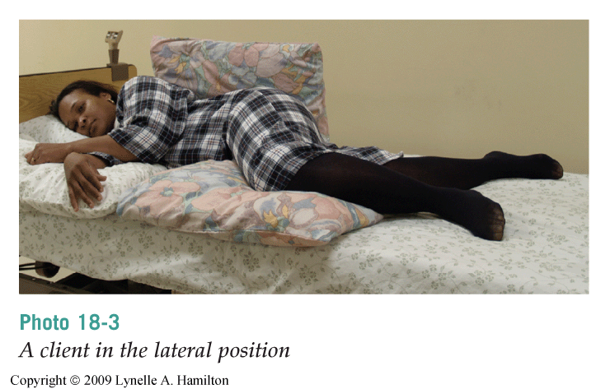
LATERAL POSITION – SIDE LYING

Slide 39
POSITIONING THE STUDENT
  Follow these guidelines to safely position a student:
    Always follow the care plan.
    Use good body mechanics
    Explain the procedure to the student
    Be gentle when moving the student
    Provide for privacy and dignity
    Provide for comfort after positioning

Slide 40
WHEN THE STUDENT IS ON THE STRETCHER:
  Safety straps are used
  The stretcher side rails are kept up during the transport
  The stretcher is moved feet first. The school-based team member is at the head of the stretcher and can watch the student’s breathing and colour
  Never leave the student alone

Slide 41
MOBILITY AIDS
Reduce weight bearing
Compensate for:
  lost balance
  strength
  coordination
Reduce pain
Enhance the person’s sense of safety and security

Slide 42
AMBULATION
Ambulation is the act of walking
Notes:
Refer to handouts

Slide 43
MECHANICAL LIFTS
Many different kinds of mechanical/electric lifts are available in school settings
Knowing one type of lift does not mean that you know the others – the basic principles remain the same

Slide 44
MECHANICAL LIFTS
  You must be trained in its use.
    It is your responsibility to ask how to use a lift if you are unsure
  It must work.
  The sling, straps, hooks, and chains must be in good repair.
  The student’s weight must not exceed the lift’s capacity.
  Always follow the manufacturer’s instructions.

Slide 45
MECHANICAL LIFTS
  Slings
      The type of sling used depends on the client’s size, condition, and other needs.
      Follow your employer’s policy and the manufacturer’s instructions for washing slings.

Slide 46
MEDIMAN
MECHANICAL LIFT
Refer to handout
  Safe Work Procedure

Slide 47
REPOSITIONING IN A CHAIR
OR WHEELCHAIR
  For good alignment and safety, the student’s back and buttocks must be against the back of the chair.
  Follow the care plan to reposition a client in a chair or wheelchair:
    Do not pull the client from behind the chair or wheelchair or pull up from under student’s armpits, as this can cause friction and shearing (red skin/skin breakdown).
    Lock wheelchair wheels
Notes:
Refer to handout: Tips for Repositioning and Positioning in a Chair
Safe Work Procedure

Slide 48
FALLS PREVENTION
Many falls can be prevented
  proper transfer techniques with appropriate mobility aids specific to the client
Observe for any unsteadiness or difficulty in walking, sitting, standing, or using stairs
Discuss environmental concerns with the teacher
Notes:
Review Handout: Universal Falls Precautions

Slide 49
ASSISTING DURING A FALL
Assist the student to attempt to minimize injury
General Guidelines
  Ensure that you maintain the best body position possible to support the fall, guiding the person gently to the ground
  Bend your knees, and continue to provide verbal cueing as you lower the client gently to the floor
  In most cases, it’s best to help the student slide down and land on his or her buttocks

Slide 50
IF A STUDENT HAS FALLEN
Follow School Policy on Post Fall and Assessment
  How a person reacts after a fall can cause more injuries than the fall itself
Notes:
How a person reacts after a fall can cause more injuries than the fall itself
Trying to get up too quickly
Trying to get up in the wrong position

Slide 51
REFERENCES:
Safe Client Handling, Workplace Health Resources . Fraser Health Authority Intranet [cited 2010, February 12, 2010]. Available from: http://fhaweb/HR+Online/People+and+Organization+Development/Workplace+Health/Safety+and+Prevention/Ergonomics/Safe+Client+Handling.htm
Sorrentino, S. Mosby’s Canadian Textbook for the Support Worker. 1st Canadian Edition. Toronto, Canada; 2001. pg.262-326.

